Slide 1
Introduction to Post Keynesian Economics
Engelbert Stockhammer
Kingston University

Slide 2
Outline
Foundations
Fundamental uncertainty
Social conflict
Effective demand
Macroeconomics
Investment → savings
Involuntary unemployment
Credit → money
Financial instability
Context:
History of PKE;
Synthesis and New Keynesians
PKE and Marxian PE
Economic Policy

Slide 3
Fundamental uncertainty
Post Keynesian Economics
Effective
demand
Social
conflict

Slide 4
Fundamental uncertainty
‘we simply don’t know’
That’s a statement about the world, not about human cognitive abilities
People can’t be ‘rational’, instead
They rely on conventions = look what other people are doing (social norms, anchoring, institutions)
Assume that the future is similar to the past (adaptive expectations)
Conventions can change rapidly (herd behaviour)
Money as a means to deal with uncertainty → liquidity preference
Possibility of liquidity crises and panic
Investment demand driven by animal spirits
Can’t make a ‘rational’ decision about long time horizon

Slide 5
Social conflict
Distributional conflict
PK models: often 3 classes: workers, capital, rentiers/financial capital
Capital hires labour; firing threat as disciplinary advise
Capitalists make investment decisions
Rentiers advance capital and receive interest + dividend payments
Have different consumption propensities
Institutions regulate and mediate conflicts
Inflation as the outcome of unresolved distributional conflicts
Note: workers and uncertainty? job insecurity

Slide 6
Effective demand
I(Y) = S(Y)
Investment → savings via multiplier process
Investment not constrained by saving, but possibly by the availability of finance
Investment expenditures are the single most important determinant of fluctuations in GDP
Have strong non-rational component
Private goods market equilibrium will in general not be at full employment equilibrium

Slide 7
UK: investment, consumption, GDP

Slide 8
Involuntary unemployment
Labour market is not self-adjusting; cannot serve as the anchor of the economy
Wage contract are nominal contracts
Wage cuts → reduction in consumption demand
→ downward pressure on prices
→ possibility of debt-deflation spiral
Real wage cut: workers have higher MPC than capitalists
→ real wage cut will be contractionary unless investment is very sensitive to profit margins
∑ No self adjustment towards full employment
Labour market dragged along with goods market; strong hysteresis

Slide 9
Money & finance
Endogenous money: credit → money
CB sets the interest (base) rate
Private financial institution mark up according to their liquidity preference (risk premium)
Financial markets prone to instability b/e forward looking (fundamental uncertainty)
Debt cycles a la Minsky: during boom investors become willing to take more risk = higher leverage = system become more fragile → endogenous cycles
Inflation as the outcome of unresolved distributional conflictions: if capital, labour and finance can’t agree on their income shares

Slide 10
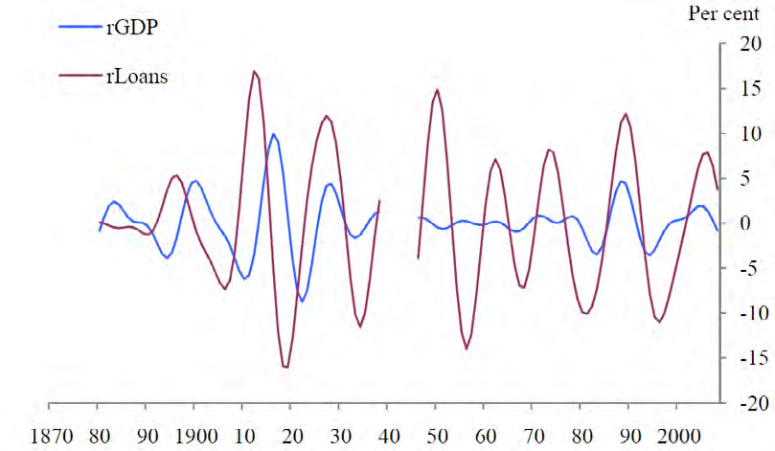
UK: cycles in rLoans and rGDP Source: Haldane (2012 BIS WP)

Slide 11
PK: development and streams
1950s + 60s: Keynes in the long run – distribution and growth;
Capital Controversies;
critique of neoclassical-Keynesian Synthesis (ISLM etc)
Where? Cambridge
70s + after: formation of PK school (journals); spreading out
Conflict inflation; endogenous money
Shift towards short/medium run analysis (Kaleckian models): distribution and demand, wage-led growth
Financial instability (Minsky)
More on economic policy, more empirical
Where? Lost Cambridge -> spreading out (USA, continental Eu..)
Streams
Sraffians: long run, distribution, technology and prices
Monetary Keynesians (incl. Minsky): uncertainty, money, short term
Kaleckians: social conflict, distribution, demand; short/medium term
Various other (often narrower streams): BoPC growth, SFC, MMT ...

Slide 12
Neoclassical vs Keynesian theory
 | Neoclassical theory | Keynesian theory
Key concepts | Rational behaviour, equilibrium | Effective demand, ‘animal spirits’
Behaviour | Rational behaviour by selfish individuals | ‘animal spirits’ (non-rational behaviour) and conventional
Markets | Market clearing ← prices adjustment | Some markets don’t clear
Money | Classical dichotomy (money is neutral) | ‘money matters’ (has real effects)
unemployment | Voluntary or due to rigidities | Involuntary, due to lack of demand on goods markets
policy | Laissez faire: markets are self-regulating and gov’t should not intervene | market economies are unstable and result in unemployment → gov’t should intervene

Slide 13
Schools of thought in macroeconomics
Marx
Keynes
neoclassical
Post-keynesians
Synthesis Keynesians
New Classcial Econ
Monetarism
Rational Expectations
RBC
New Keynesians

Slide 14
New Keynesians
in 1980s (Mankiw, Blanchard, Stiglitz, Fisher)
reaction to New Classicals - accept microfoundations and often rational expectations
but assumes (or derives) imperfect markets –
menu costs,
NAIRU, insider outsider models
credit rationing / asymmetric information
1990s: “New Consensus Model” (New Keynesian-Neoclassical Synthesis):
again short run/long run dichotomy, but with strict microfoundations
Pseudo IS curve: downwards sloping because of intertertemporal consumption

Slide 15
 | PKE | Marxian econ
scope | Economic theory | Part of richer, interdisciplinary project (Historical Materialism)
Demand | Effective demand | Often assumes Say’s law; demand (‘realisation crisis’) only in short run
Production | Little to say to production | Production as labour process
Class analysis | classes have different consumption propensities; only capitalists make investment decisions | Class struggle at site of production Class struggle -> theory of state
Money & finance | Money is created by banks as side effect of lending Money to deal with uncertainty | Commodity theory of money: money is produced commodity
unemployment | Lack of effective demand; no tendency to full employment | Industrial reserve army necessary to discipline workers
policy | Normative: full employment policy; can also benefit capital | Reform futile within the capitalist system

Slide 16
PK and mainstream economic policy
 | Mainstream Policy Mix | Post Keynesian Policy Mix
Overall aim | Efficiency (minimal interference in markets) | Full employment
fiscal policy | Balanced budgets (‘sound fiscal policy’) | Countercyclical fiscal policy to ensure full employment
Monetary policy | Inflation targeting | Has to support growth; In recession with debt hangover: higher inflation allows rebalancing
Labour market | Encourage ‘labour market flexibility’ Wage as a cost factor | Institution building Wages as source of demand
Financial market | financial liberalisation, trusts efficiency of financial markets | Regulate finance

Slide 17
Illustrating different paradigms
 | Austrians | Mainstream | PK | Marxist
Financial crisis | ‘too low interest rates’ | Random shock; Wrong incentives to bank mangers → excessive risk taking | Unregulated financial (animal spirits + endogenous credit) → boom-bust cycles | Reflects more fundamental contradictions of capitalism (exploitation)
Recession / unemployment | Economic crisis as cleansing process | Swift return to equilibrium | No built-in mechanism to return to full employment | Unemployment a normal feature; necessary to maintain discipline
Government interventions | avoid | May be useful in short run | Necessary for socially desirable outcomes | Futile in capitalism

Slide 18
Reading suggestions
classics
Keynes: General Theory of Employment, Interest and Money
Kalecki: Theory of Economic Dynamics
Robinson: Accumulation of Capital
Minsky: Stabilizing an Unstable Economy
Introductions, surveys, history
Lavoie: Introduction to Post Keynesian Economics
Hein & Stockhammer: A New Guide to Keynesian Macroeconomics and Economic Policies
King: History of Post Keynesian Economics

Slide 19
Conclusion: PKE
foundations
Fundamental uncertainty
Social conflict
Effective demand
Macroeconomics
Investment → savings
Involuntary unemployment
Credit → money
Financial instability

Slide 20
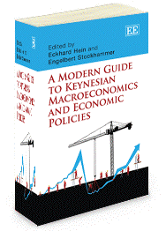
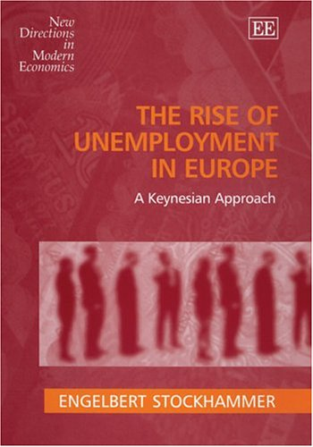

Slide 21
Appendix

Slide 22
PKSG & PERG
An Introduction to Post Keynesian Economics and Political Economy
14-16 July 2016, Kingston University
E Stockhammer, M Sawyer, V Chick, S Mohun, O Onaran, S Keen, G Dymski
http://fass.kingston.ac.uk/research/perg/events/
PKSG Annual Workshop, June
FMM conference, Oct
FMM summer school, Aug, every other year
PKSG email list http://www.postkeynesian.net/

Slide 23
PK goods market: basic multipliers
Standard Keynesian multiplier
C = c₁.Y +c₀
I = I₀
In equilibirum
Y = C + I₀
Y* = 1/(1-c₁).(C₀+I₀)

Slide 24
Different consumption propensities for profit income and wage income
C = c_{W}.W + C_{R}.R π=R/Y (profit share)
C = c_{W}.(1-π).Y + c_{R}. π.Y
Y = c_{W}.(1-π).Y + c_{R}. π.Y + c₀ + I₀
Y* = 1/(1- c_{W} +π[c_{W} - c_{R}]).(c₀ + I₀)
If workers don‘t save: c_{W} = 0
Y* = 1/π(1-c_{R}).(c₀ + I₀)
dY*/d I₀ = 1/π(1-c_{R})
dY*/dπ = -1/π²(1-c_{R}) < 0

Slide 25
Wage-led versus profit-led demand
Y = C + I + NX
Increase in profit share
Negative effect on consumption
Positive effect on investment
Positive effect on net export (for an individual country)
Y = C(Y, π) + I(Y, i, π) + NX(Y, π; Y^{W}, ex)
Y income, i.. Interest rate, π..profit share, D..debt, Y^{W}..world GDP, ex..exchange rate, P.. price level, p..inflation
dY*/dπ = h₁/(1-h₂)
h₂ = dC/dY + dI/dY + dNX/dY
h₁ = dC/dπ + dI/dπ + dNX/dπ
neg + pos + pos = ??
If h1 > 0 profit-led demand
If h1 < 0 wage-led demand

Slide 26
Net Effects: ∆Y/∆WS
 | Effects on private excess demand
 | EU 12 (openness 15%) | Austria (openn. 50%)
Consumption | 0.37 | 0.36
Investment | -0.07 | -0.15
Domestic sector | 0.30 | 0.21
Net exports | -0.09 | -0.39
Total effect | 0.21 | -0.18

Slide 27
Comments about the state of ‘Economics’
Theoretical and methodological monoculture (‘neoclassical economics’)
Microfoundations (rational behaviour)
a scholastic science: self-referential
Journal ratings
RAE/REF
Has proven utterly dysfunctional as regards the crisis
CB models don’t have a role for the financial sector or bankruptcies
DSGE models regard the crisis as a ‘random shock’
EMH has encouraged financial deregulation

Slide 28
Teaching Economics: pluralism!
Different theories: neoclassical, New Keynesian, neo-Austrian, Post Keynesian, Marxist, Behavioural Econ
Problem-oriented (as opposed to theory guided):
Topics like unemployment, financial crises …
Economic history!
Should encourage methodological pluralism: quantitative as well as qualitative methods

Slide 29
Illustrating different paradigms
 | Austrians | Mainstream | PK | Marxist
Financial crisis | ‘too low interest rates’ | Random shock; Wrong incentives to bank mangers → excessive risk taking | Unregulated financial (animal spirits + endogenous credit) → boom-bust cycles | Reflects more fundamental contradictions of capitalism (exploitation)
Recession / unemployment | Economic crisis as cleansing process | Swift return to equilibrium | No built-in mechanism to return to full employment | Unemployment a normal feature; necessary to maintain discipline
Government interventions | avoid | May be useful in short run | Necessary for socially desirable outcomes | Futile in capitalism

Slide 30
PKE and Ecological Economics
For long time little interaction (hetecon is highly segmented)
Recently attempt from both side
Similarities: market economies don’t generate optimal outcomes; non-rational behaviour, uncertainty, hysteresis, explosive dynamics, concern for equality
Tension: EE often de-growth, PKE often pro-growth
PKE: analytical: demand (animal spirits, finance etc) does determine growth; normative: capitalist growth normally not sufficient for full employment
EE: normative: ecological constraints = supply-side constraints should determine growth in order to stay within ecological boundaries (sustainability)
Synthesis?
Need a framework that has social as well as environmental externalities
Need a modes of production approach to theorise non-capitalist employment relations

