Slide 1
Author | Where now | Where published | Of interest
John Fender | Prof of economics, Birmingham University | Economic Journal | Book: Understanding Keynes: An Analysis of the ‘General Theory’ (1981) Recent paper: ‘In (Partial) Defence of Fiscal Austerity’
John McCallum | Liberal member of Canadian Parliament since 2002 | Journal of Economic Literature | Previously chief economist at Royal Bank of Canada
J. Stephen Ferris | Carelton University Distinguished Research Professor | The Journal of Money, Credit and Banking | Expertise: interaction of economic and political processes • government size • fiscal policy
Robert Solow |  | Journal of Political Economy
John Foster | Professor of Economics at University of Queensland since 1991 | Economica
Roger Wayne Garrison | American professor of economics at Auburn University, and an adjunct scholar of the Ludwig von Mises Institute | Southern Economic Journal | proponent of the Austrian School of economics; book: Time and Money, ”which presents a graphical framework for capital-based macroeconomics and offers a critique of Keynesian graphical analysis”.
Methodological content:
NONE
CONFUSED
EXCELLENT

Slide 2
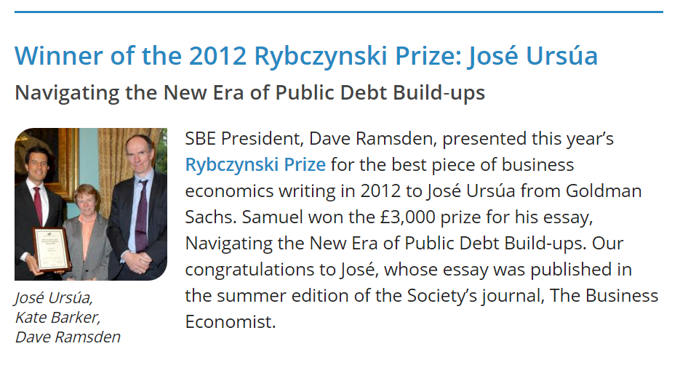

Slide 3
