Slide 1

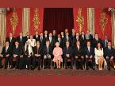
Keynes Redux: History Catches Up
Radhika Desai
University of Manitoba
Paper presented at the Association for Heterodox Economics
Kingston University, 9-12 July 2009

Slide 2
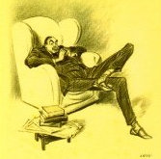
Outline
The Return of Who?
Dollar’s Future
Keynes’ Defeated Proposals
The Radical Keynes
The Historical Keynes
The After-life of Imperialism
Third Time Lucky?

Slide 3
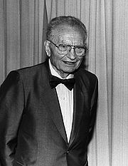
Professor Samuelson, I Presume?
Keynes invoked, but
Stimulus Packages small
No Redistribution
Bailouts reward rentiers
Socialization of losses, not investment
Crisis treated as episodic, not systemic
New Bretton Woods discussion confused: Didn’t Keynesian BW fail?

Slide 4

Future of the Dollar
Questions raised well before crisis: Imbalances: George, Monbiot, Stiglitz, Arrighi etc.
Crisis Rush to safety temporarily raises value
Holders’ dilemma
Chinese proposals for new international currency
Japanese DP proposals to stop underwriting dollar
UN commission of experts on reforms of international financial and monetary system

Slide 5
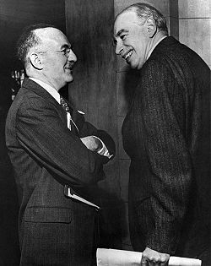
The Defeated Proposals
Capital Controls
Bancor
Creditor responsibility
Surplus country responsibility
Balanced Trade
Only Capital Controls accepted in BWI
They too abandoned in BWII
BWII = Anti Keynesian

Slide 6
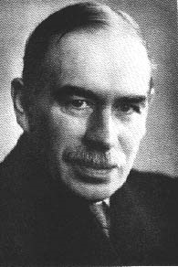
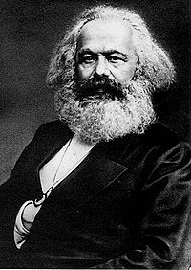
The Radical Keynes
Where classical and neoclassical thinkers took the level of economic activity and employment as given, he took it as his chief explanandum.
Where they assumed away the problem of unemployment, he made solving it the chief policy priority.
Where they regarded saving virtuous, to be rewarded with interest, he criticized it as a vice of the “functionless investor,” to be discouraged by driving interest rates near zero and keeping them there, “euthanizing the rentier.”
Where they loathed and feared state intervention, he advocated its use, up to and including the “socialisation of investment,” to achieve full employment.
Where they opposed protectionism, he advocated a national economy. W
Where they pursued efficiency single-mindedly, he quietly insisted on sufficiency.
And where they worshipped at the altar of the supposedly neutral gold standard, Keynes exposed the historical conditions which made it appear neutral and thepolitical conditions in which it became acceptable for a short time.

Slide 7
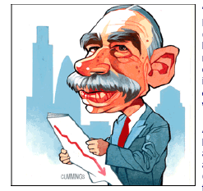
The Historical Keynes
Liberal to social democrat
Dissatisfaction with 19th century liberalism
Emergence of inter-national economy (Bukharin, Hilferding etc.)
Also of Polanyi’s ‘double movement’: popular social forces (working class) = mass politics
Not prey to 19th century ‘cosmopolitan bias’
Critique of Gold Standard based on this (Eichengreen).
Macroeconomics: understanding national capitalisms
National Income Accounting
As spokesperson of a weak and war-torn economy against the mightiest economy, Keynes’ proposals has relevance to Third World Countries

Slide 8
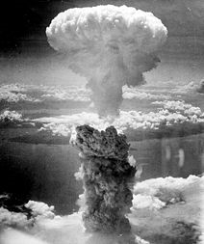
After-Life of Imperialism
Keynes not defeated by White
But by US power
US power already great
But increased by war to enormous
Despite talk of hegemony dollar never an adequate international currency:
1950s: ‘Dollar Shortage’
1960s: Dollar Glut and ‘Triffin Dilemma’
1970s: Pure Dollar Standard backed by Oil
1980s: Oil + high interest rates
1990s: Oil + Greenspan’s Put + Stock Market Bubble
2000s: Oil + Greenspan’s Put +Housing Bubble

Slide 9
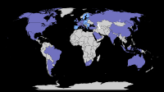
Third Time Lucky?
The world Keynes spoke for, postponed by wartime increase in relative US power, now here?
Though US remains largest, larger number of countries of substantial economic weight also must be accommodated
Not G-192, but nevertheless improvement.
But historical necessity does not act, people do.
Need to advocate and agitate for greater economic justice.

Slide 10
National Income Accounting
‘Until well into the depression the United States had no useful figures on the level or distribution of employment. There was a certain classical logic to this; one did not spend money collecting information on what, in high economic principle, could not exist’.
National income ‘showed the value of the total production of goods and services of all kinds, public and private. The Gross National Product. And in companion tables, they showed the income derived therefrom by kind and source. National income. That the latter needed to be sufficient to buy the former was a thought that no one could henceforth escape. Nor, more specifically, the thought that savings from the income now shown might not all be used – that they might not be absorbed by the spending for investment goods also shown in the tables. And it was evident how serviceably an increment of income, as from government expenditure, would make up any shortfall investment spending or consumer borrowing and add to the purchase and production of goods. (Galbraith 1971: 245-6)

Slide 11
Keynes versus Behemoth
‘The Agreement was shaped not by Keynes’s general theory, but by the U.S. desire for an updated gold standard as a means of liberalising trade. If there was an underlying ideology, it was Morgenthau’s determination to concentrate financial power in Washington.’ (Skidelsky)
Keynes had entered the negotiations with hope but left them in bitterness, complaining that ‘The Americans at the top seem to have absolutely no conception of international cooperation; since they are the biggest partners they think they have the right to call the tune on practically every point. If they knew the music that would not matter so much; but unfortunately they don’t’. (Keynes in Skidelsky)

